Slide 1
Analyzing the Impact of Demographic, Socioeconomic, and Racial Factors on COVID-19 Risk and Outcomes in U.S. Counties
Team Members
Aakriti Bhandari,
Sai Sathvik Appagana,
Sai Srilekha Aluru,
Sri Jahnavi Adusumilli.

Slide 2
INTRODUCTION
Problem Statement:
The COVID-19 pandemic has revealed stark disparities in health outcomes based on socioeconomic, racial, and demographic factors. Minority populations and individuals living in poverty are disproportionately affected by COVID-19 morbidity and mortality. This highlights the critical need to explore the relationships between these factors and their role in determining health risks.
Addressing the Problem Statement Using Statistical Analysis:
Our study utilizes the dataset to examine how socioeconomic and racial factors influence COVID-19 cases, deaths, and health risk categorizations in U.S. counties. By leveraging techniques such as Exploratory Data Analysis (EDA), such as visualizations of the variables, hypothesis testing, and statistical analysis like chi-square, Kruskal-Wallis, Spearman’s correlation, multicollinearity regression modelling, logistic model we aim to uncover correlations between poverty rates, demographic distributions, and COVID-19 outcomes. These insights will help inform policies aimed at reducing health disparities and improving preventive measures during future health crises.

Slide 3
INTRODUCTION
Research Question:
How do socioeconomic, demographic, and racial factors influence the cumulative number of COVID-19 deaths?
How do these factors influence the risk category across different U.S. states and counties?
Hypothesis Testing:
Null Hypothesis: There is no significant relationship between demographic, racial and socio-economic factors and COVID-19 outcomes (cumulative deaths) across U.S. counties and states. There is no significant relationship between demographic, racial and socioeconomic factors and the risk category across different U.S. counties and states.
Alternative Hypothesis: There is a significant relationship between demographic, racial and socio-economic factors and COVID-19 outcomes (cumulative deaths) across U.S. counties. There is a significant relationship between demographic, racial and socioeconomic factors and the risk category across different U.S. counties and states.

Slide 4
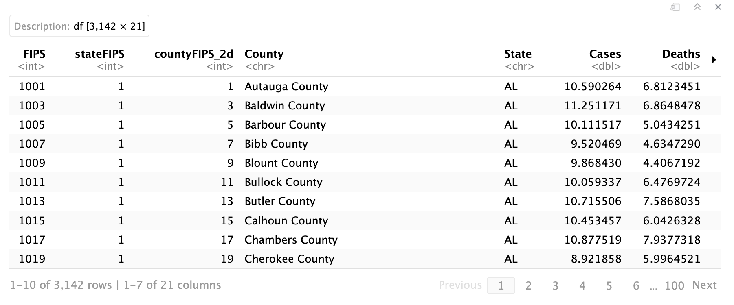
DATASET DESCRIPTION
Dataset and Source:
The analysis utilizes the COVID-19 Race, Gender, and Poverty Risk Dataset from Kaggle, incorporating data from reputable sources such as USA Facts, U.S. Census, CDC, and Policy Map. The dataset comprises 3,142 rows representing U.S. counties and 21 variables, offering valuable insights into health disparities.
Link to dataset: https://www.kaggle.com/datasets/laurindogarcia/covid-19-race-gender-poverty-risk-us-county

Slide 5
The key variables in this dataset are:
COVID-19 Deaths (Deaths): Cumulative number of deaths per 100000 population due to COVID-19 in each county.
COVID-19 Cases (Cases): Cumulative number of COVID-19 cases per county.
Poverty Rate (Poverty): Percentage of the population living below the poverty line in each county, capturing their socioeconomic factor.
Demographic Breakdown by Race and Gender: Population distribution by race and gender, allowing for a detailed exploration of racial and gender disparities. The variables are :
W_Male, W_Female: White male and female population.
B_Male, B_Female: Black male and female population.
H_Male, H_Female: Hispanic male and female population.
I_Male, I_Female: Indigenous male and female population.
A_Male, A_Female: Asian male and female population.
NH_Male, NH_Female: Non-Hispanic male and female population.
Health Risk Index (Risk_Index) : Composite index representing the relative health risk of each county, based on underlying health and socioeconomic conditions.
County: Name of county in the United States
State: Name of states in the United States
Health Risk Category (Risk_Cat): Classifies counties into different risk categories (e.g., "Above Average", "High") based on their health risk index.

Slide 6
DATASET DESCRIPTION
 | CATEGORICAL |  | QUANTITATIVE
 | NOMINAL | ORDINAL | DISCRETE | CONTINUOUS
INDEPENDENT VARIABLES | County, State | - | - | Poverty rate, Demographic breakdown of Race and Gender, Health Risk Index, COVID-19 Cases
DEPENDENT VARIABLES | - | Health Risk Category | - | COVID-19 Deaths

Slide 7
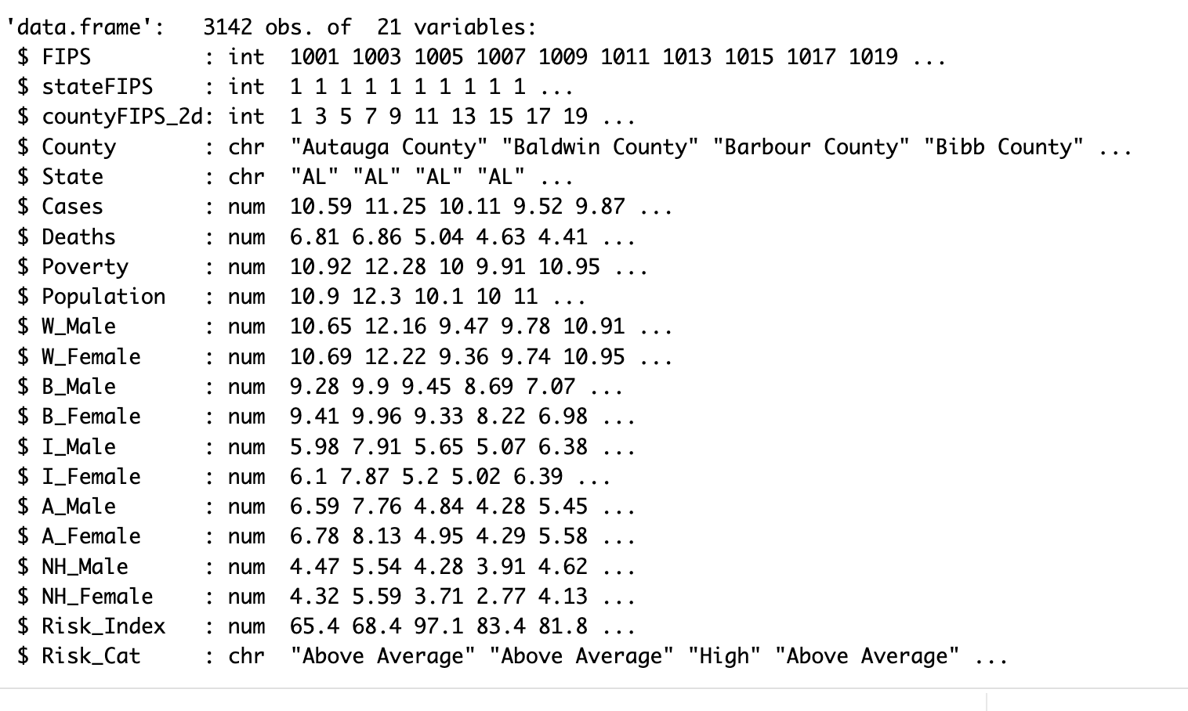
The structure of our dataset

Slide 8
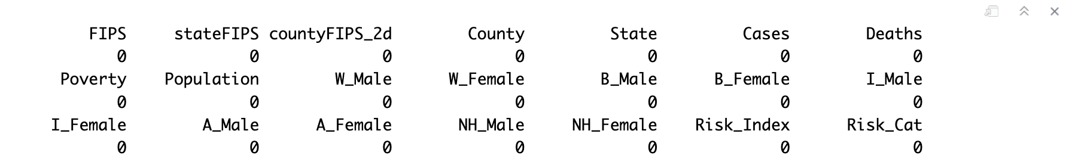
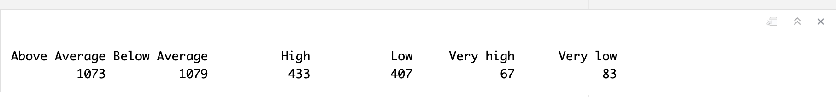
DATASET DESCRIPTION
We identified null values using colSums(is.na(data)) and found no null values for each variable.
We identified the unique values of each category in the Risk_Cat variable.

Slide 9
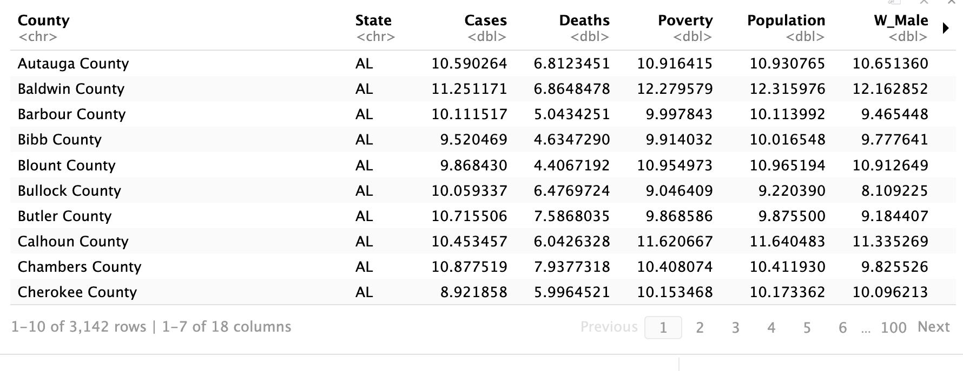
DATASET DESCRIPTION
We dropped the first 3 columns – as they were not related to our research question

Slide 10
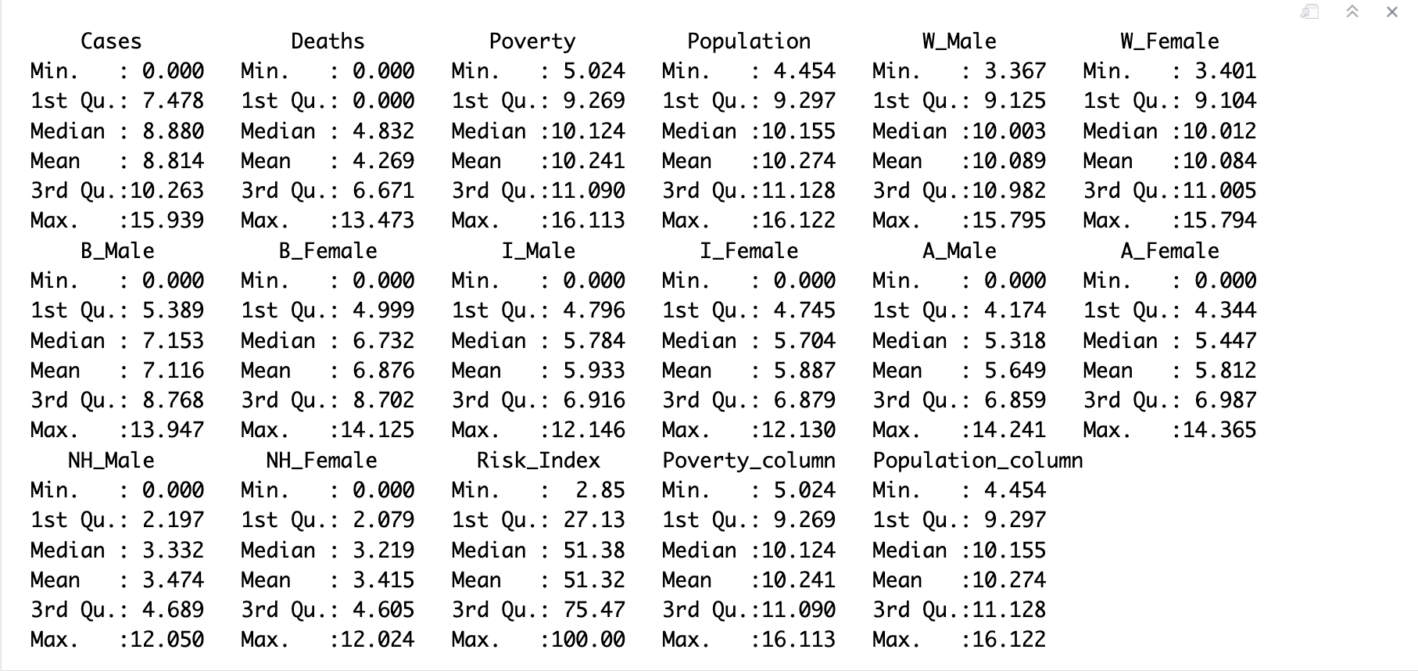
DESCRIPTIVE STATISTICS
We identified the descriptive statistics of each variable using the summary() function. These statistics include mean, median, minimum value, maximum value, 1st and 3rd quartiles.

Slide 11
EXPLORATORY DATA ANALYSIS
Histograms are used to show the distribution of continuous variables like COVID-19 cases and deaths
Bar charts are used to visualize categorical variables like risk categories.
Scatter plots are plotted to visualize the relationships between poverty and COVID-19 cases, poverty and population and population size and deaths
The distribution of Population and Poverty across various states respectively is visualized through bar charts.
A Pie chart is used to visualize all the states in the dataset
Bar charts were plotted to visualize racial and gender distribution across different states

Slide 12
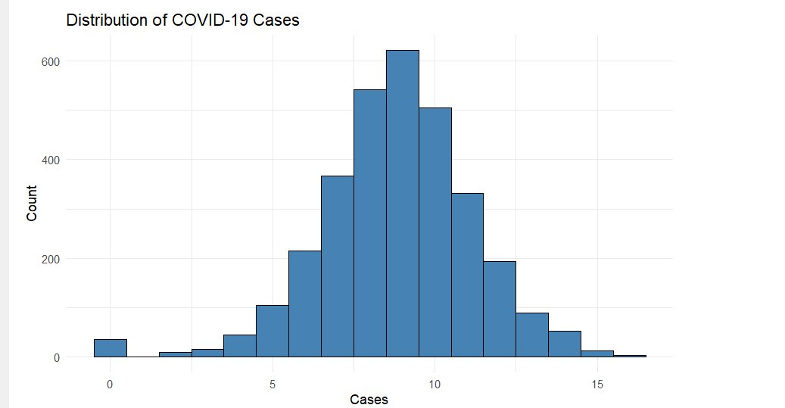
Distribution of COVID-19 Cases:
The distribution of COVID-19 cases in U.S. counties is not uniform. Most counties report the majority of data points cluster around a central value, with fewer points appearing as you move away from the center in both directions. This indicates that the pandemic's impact was widespread but varied, with some areas experiencing more severe outbreaks.

Slide 13
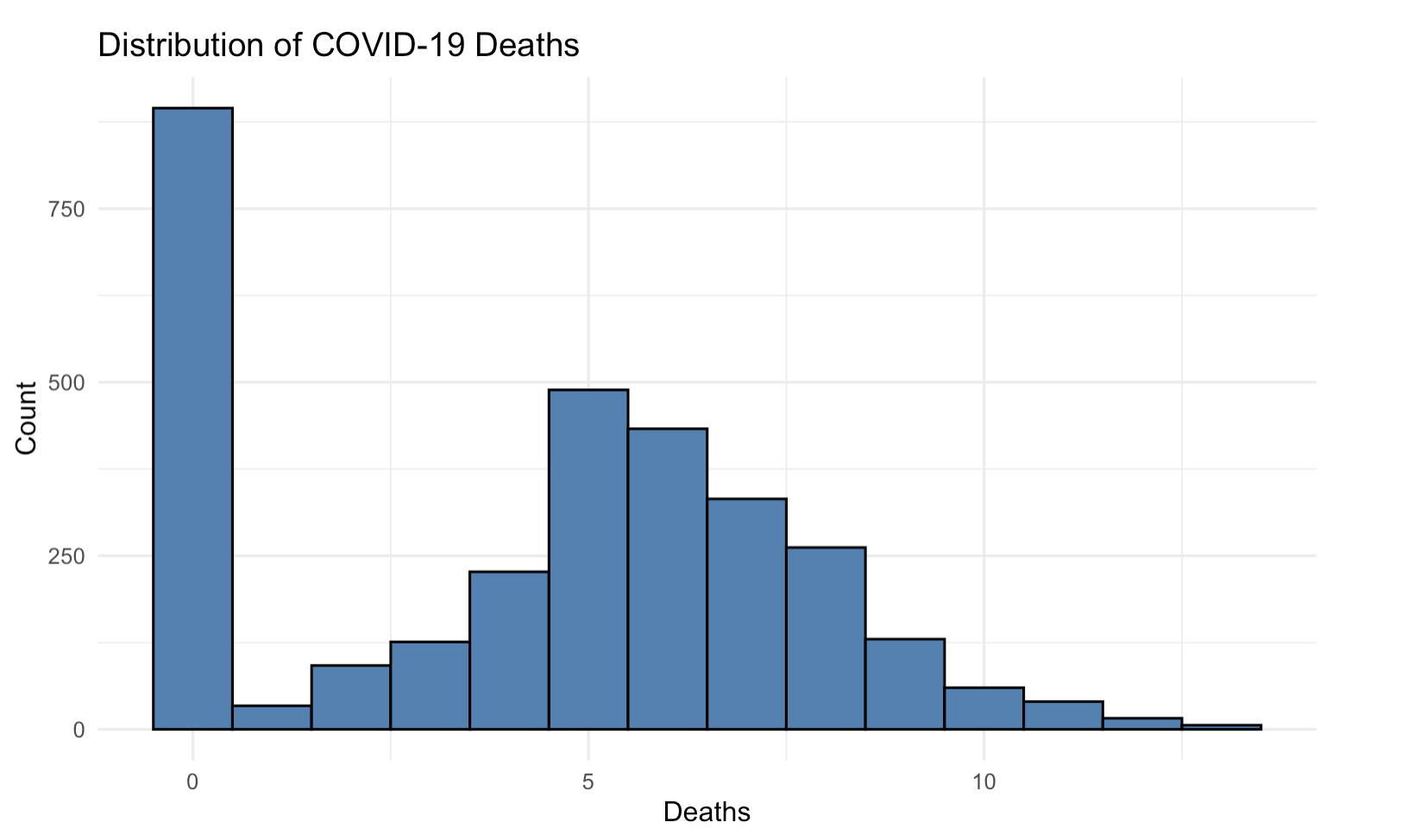
Distribution of COVID-19 Deaths:
The distribution of COVID-19 deaths by count shows that most report zero deaths and the frequency starts increasing after 0, which later decreases as the number of deaths rises. This suggests that a few or no deaths occurred majorly and higher deaths occurred in smaller proportions

Slide 14
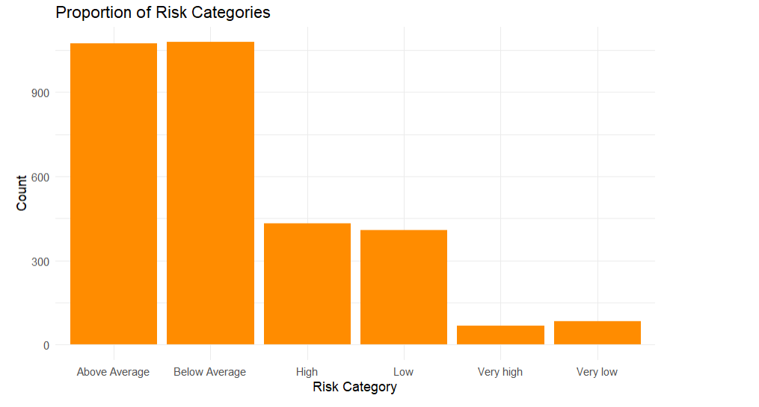
Risk Categories in U.S. Counties:
The risk categories indicate that many counties were classified as "Above Average Risk" or "Below Average Risk," while fewer fell into the "High Risk" or "Very High Risk" categories. This distribution highlights a gradient in health disparities, likely shaped by factors such as healthcare infrastructure, socio-economic conditions, and public health initiatives.

Slide 15
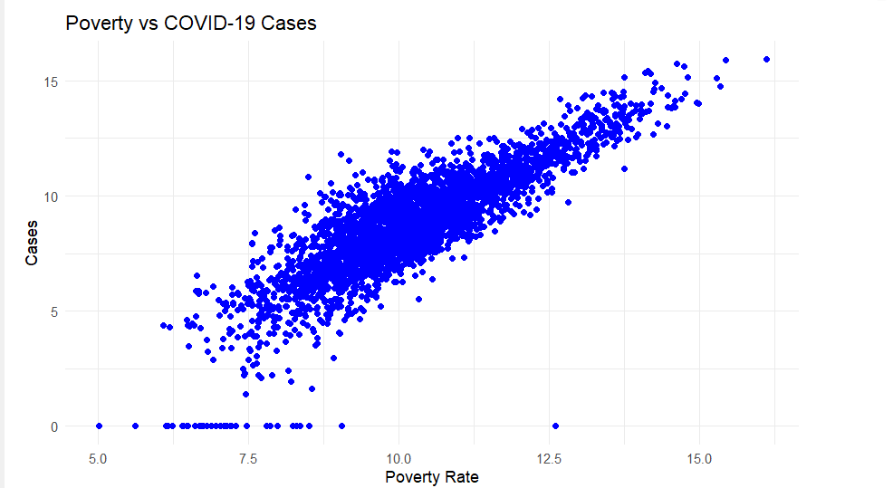
COVID-19 Cases and Poverty Rates:
Analysis of COVID-19 cases shows a clear relationship between poverty and the number of cases. Counties with higher poverty rates tend to have more COVID-19 cases. A strong positive correlation between these two variables suggests that socio-economic conditions may have influenced the spread of COVID-19 across U.S. counties.

Slide 16
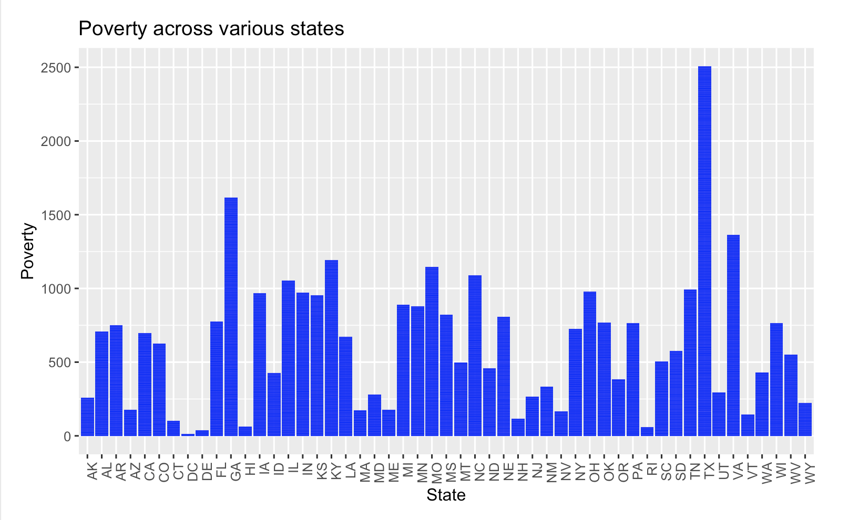
Poverty across different states:
The poverty distribution across states shows significant variability, with some states like Texas having much higher poverty levels than others. Most states exhibit moderate to lower poverty counts, with a few notable outliers.

Slide 17
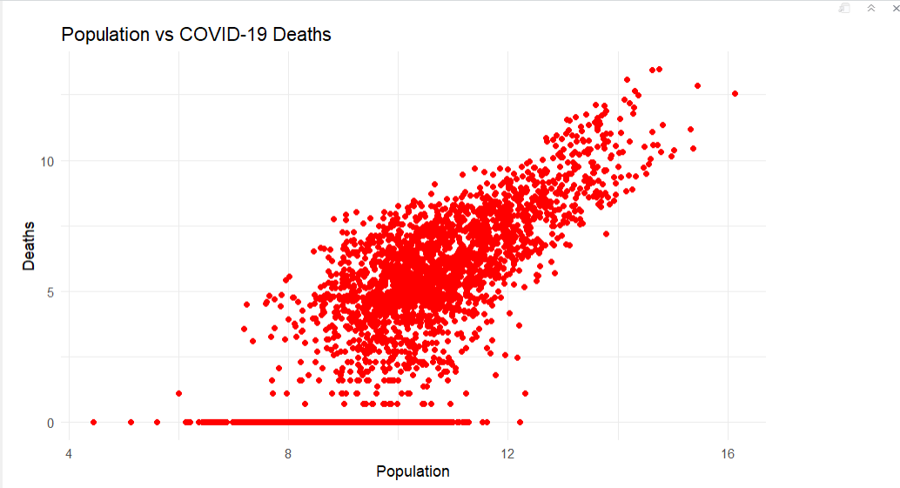
COVID-19 Deaths and Population:
COVID-19 deaths follow a similar pattern to cases, with larger counties (in terms of population) experiencing more deaths. However, the data also reveals that counties with higher population density may be at greater risk.

Slide 18
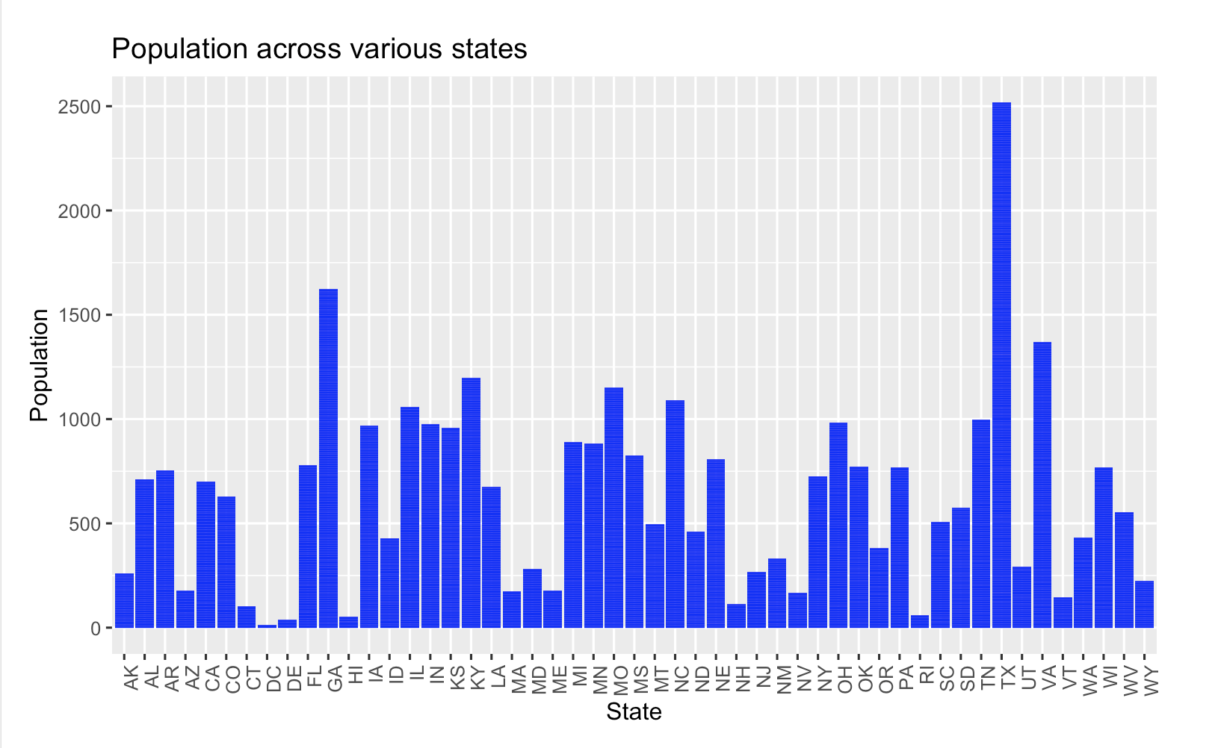
Population across various states: This chart demonstrates the population distribution across U.S. states, with significant disparities in population size. Texas (TX) has the highest population, followed by Georgia(GA) as an outlier. States like District of Columbia(DC) and Delaware(DE) have relatively smaller populations, reflecting uneven distribution.

Slide 19
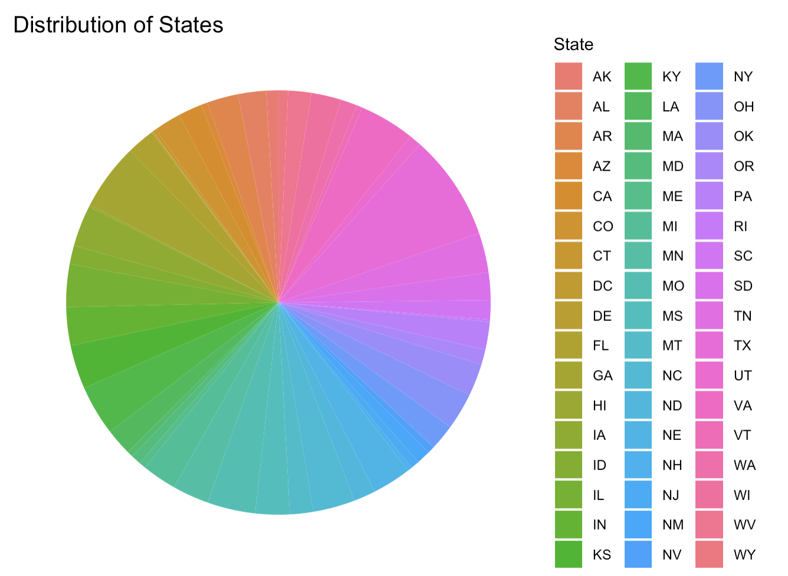
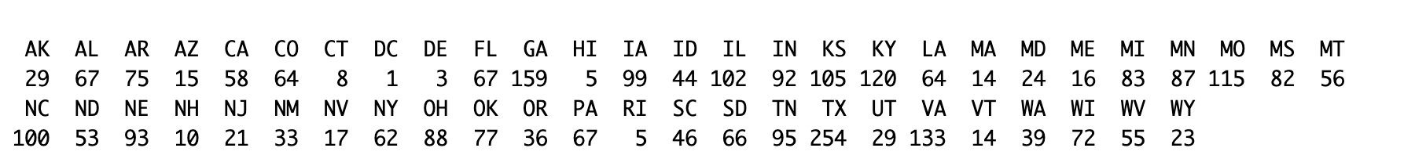
Distribution of states in our dataset:
The pie chart shows how often each U.S. state appears in the dataset, with the size of each slice representing its frequency. States such as Texas (TX) are more prominent, while smaller slices, like Hawaii (HI), the District of Columbia(DC) and Delaware (DE) indicate lower occurrences. A color-coded legend provides a clear reference for identifying and comparing states.

Slide 20
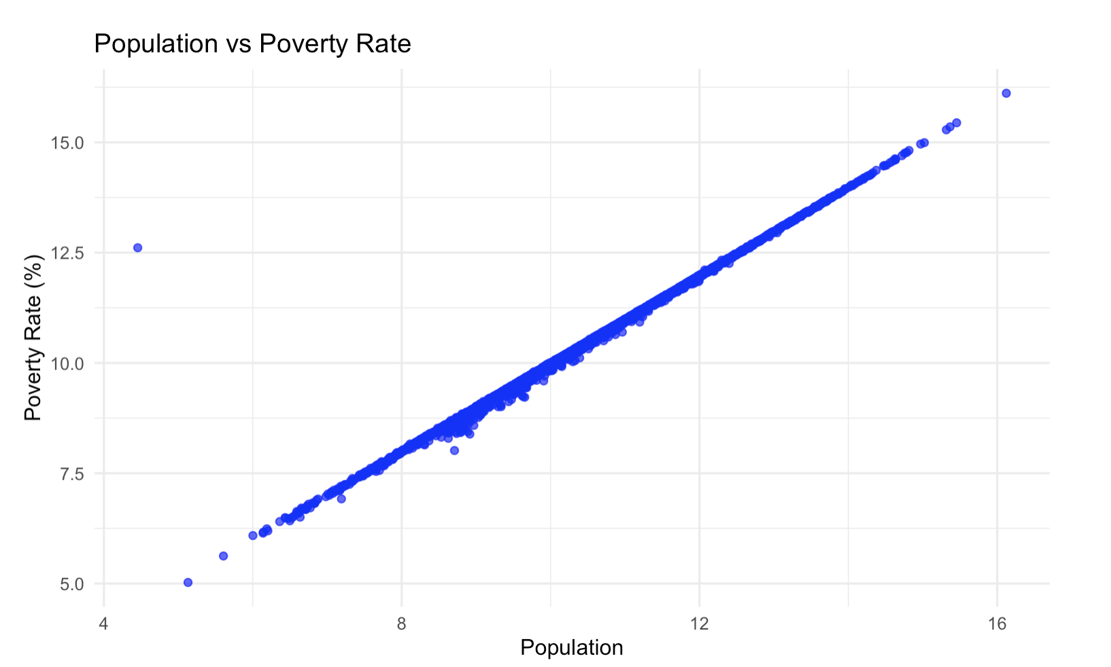
Population vs Poverty Rate: This scatter plot shows a strong positive linear relationship between population and poverty rate. As population increases, the poverty rate rises proportionally, with data points tightly clustered along a straight line. This indicates a very high correlation, suggesting that areas with larger populations tend to have higher poverty rates.

Slide 21
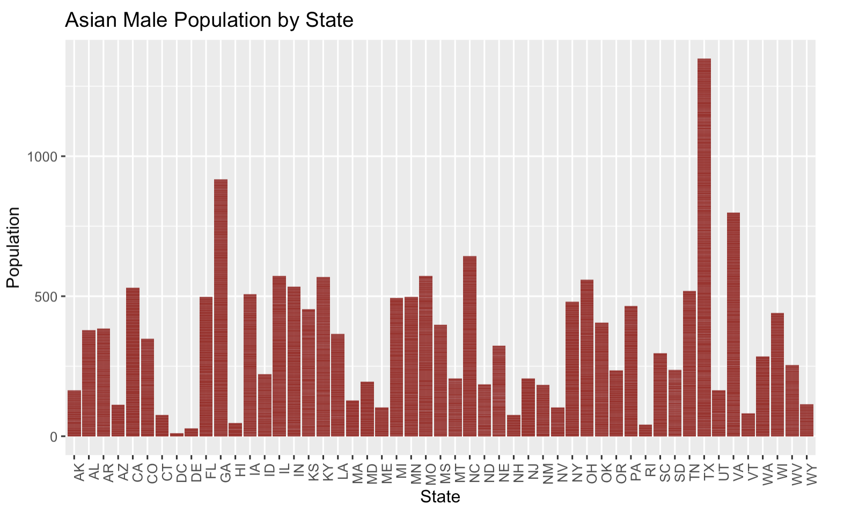
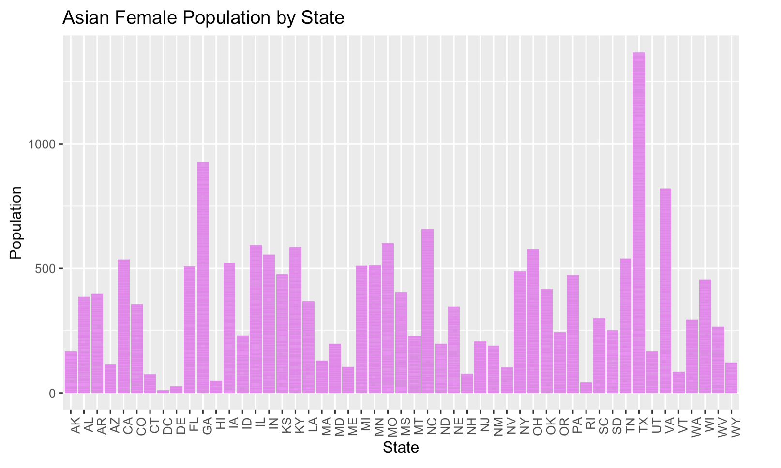
Racial and gender distribution across states: The following bar charts show the distribution of population of various racial and gender categories across various states

Slide 22

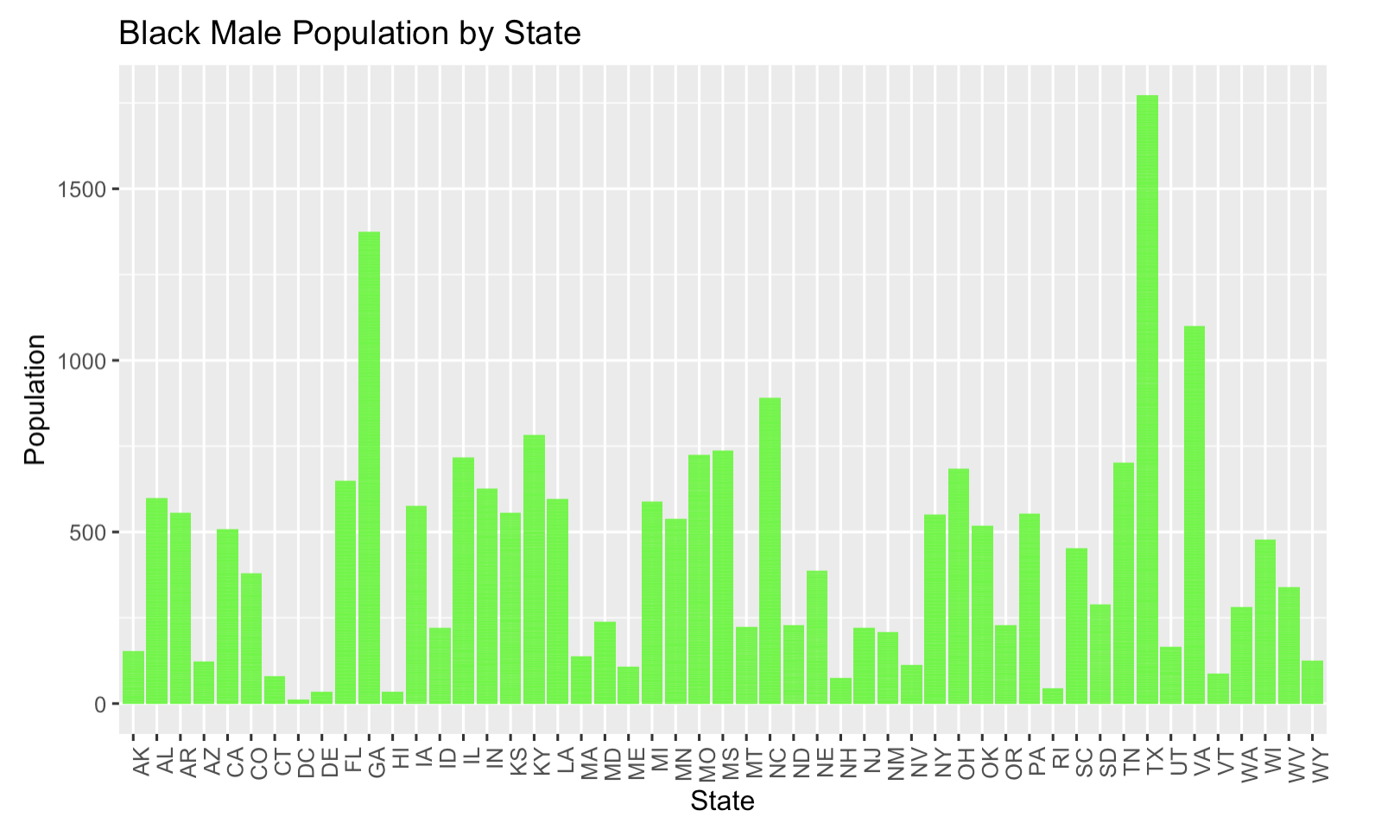
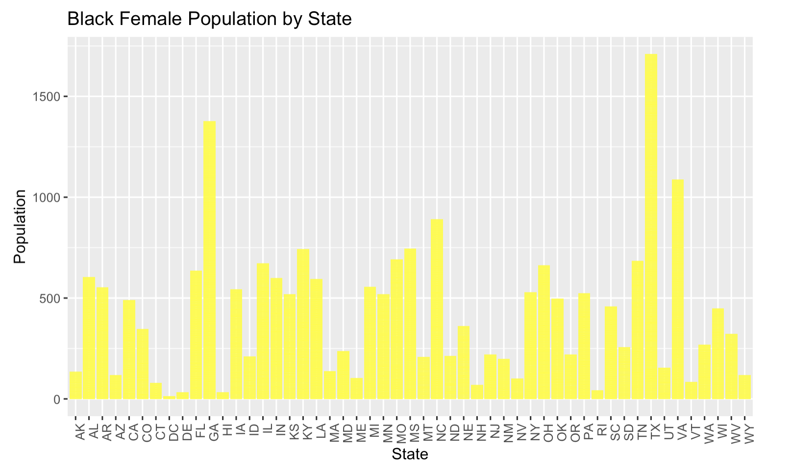
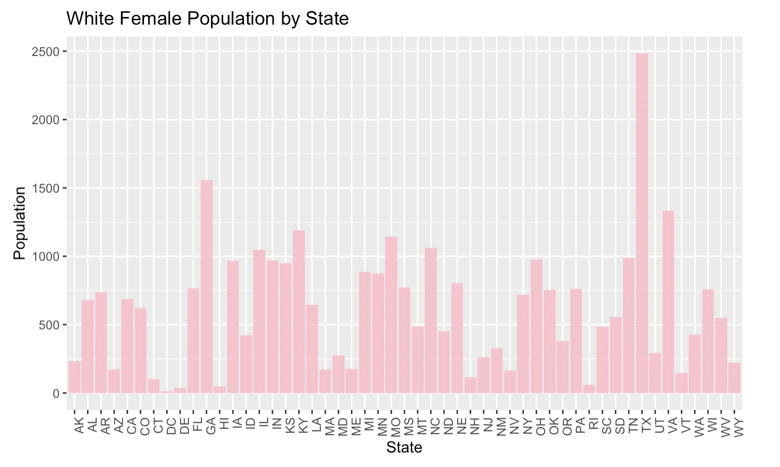

Slide 23
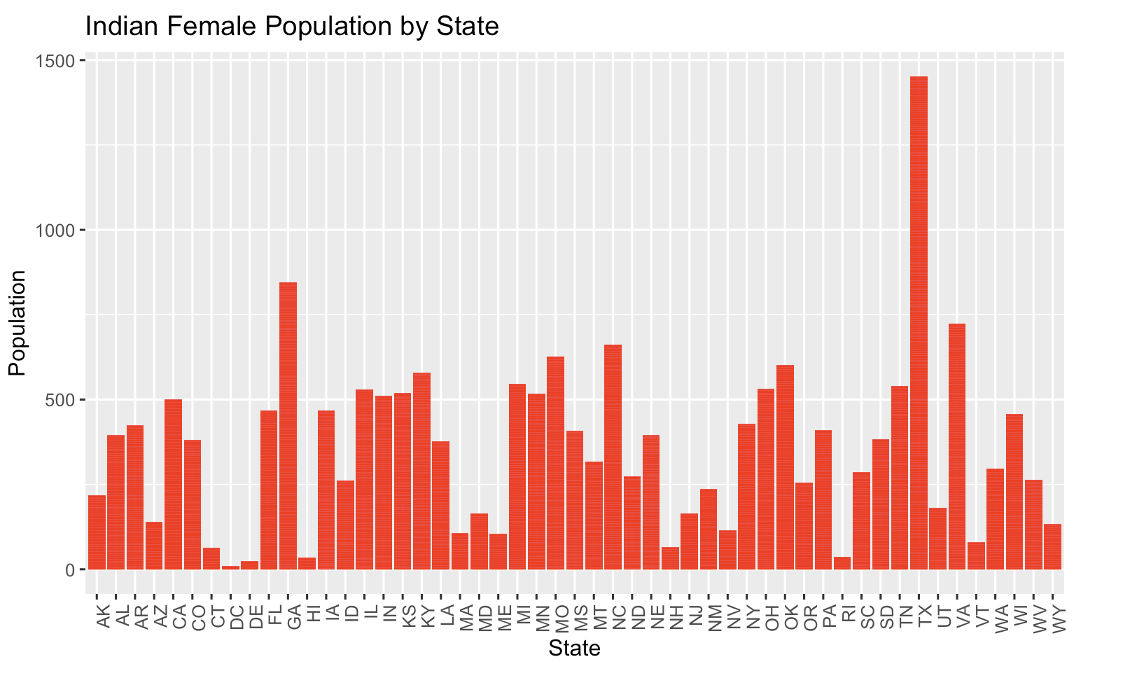
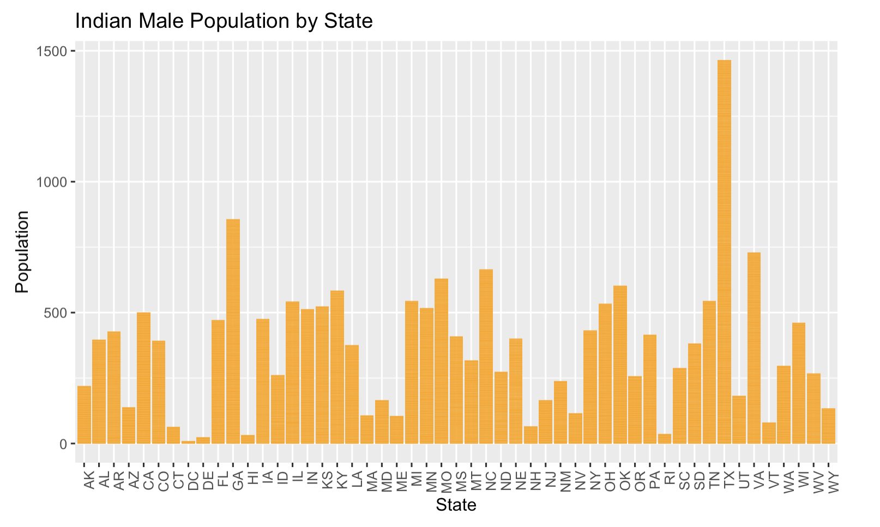
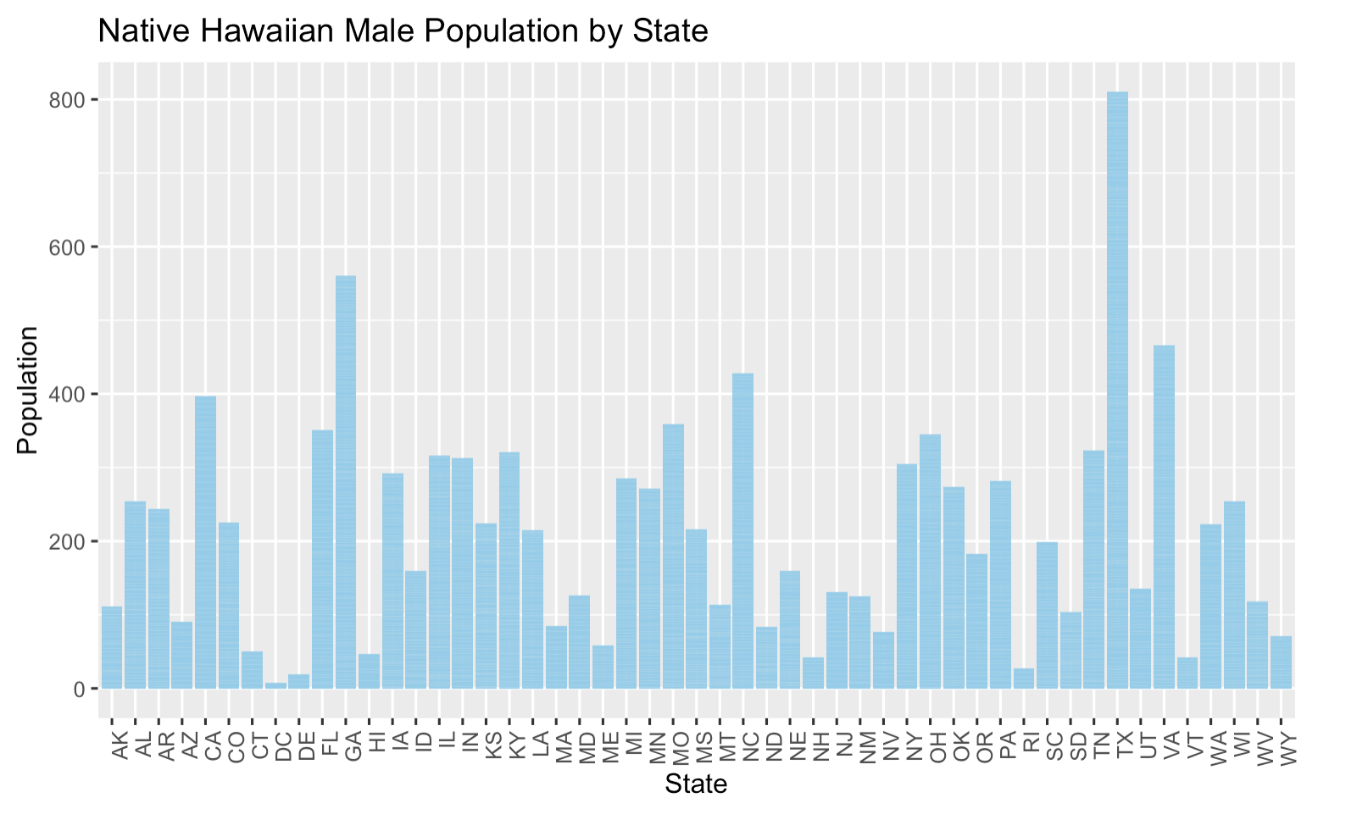
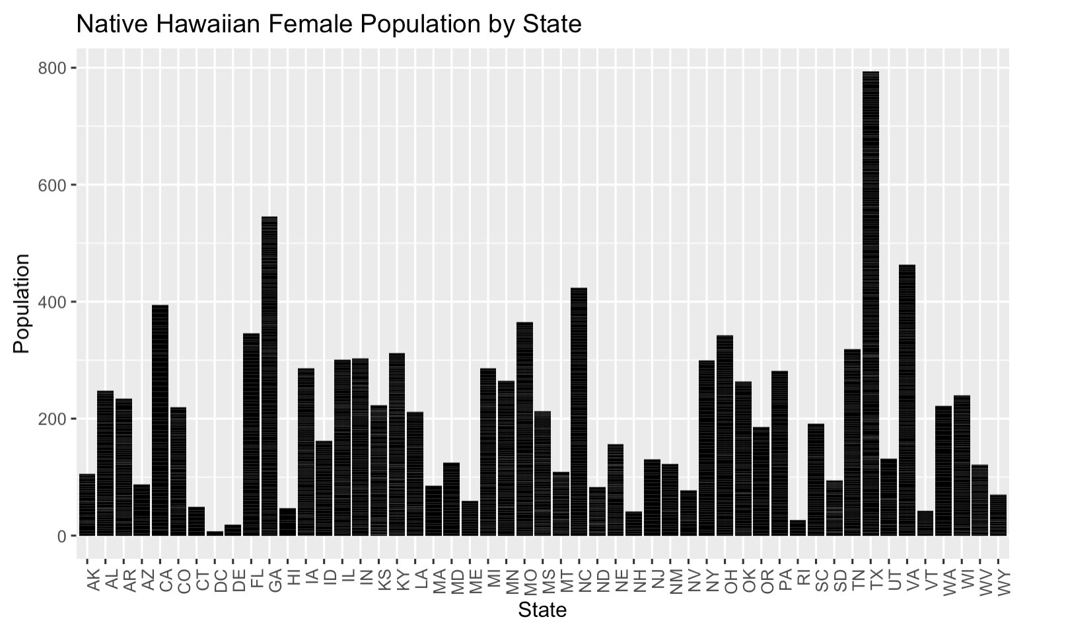

Slide 24
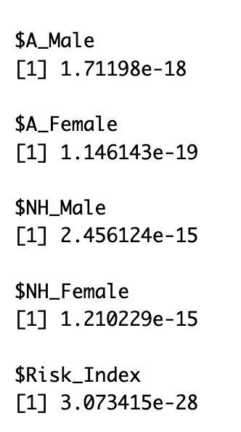
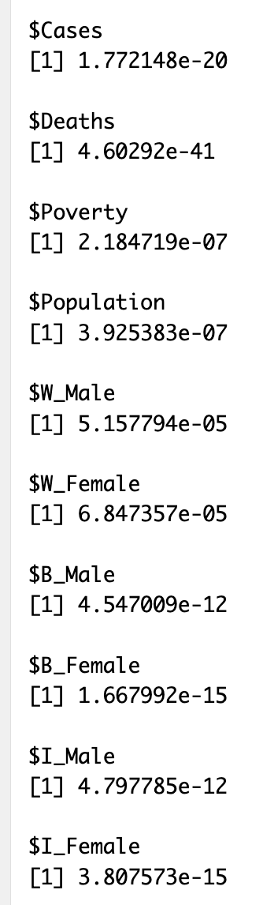
DISTRIBUTION & NORMALITY
Null hypothesis - The data follows the normal distribution
Alternative hypothesis - The data does not follow the normal distribution
We performed Shapiro-Wilk test to test for normality of our data.
As the p-value is less than 0.05, we reject the null hypothesis. So, the whole variables do not follow the e normal distribution

Slide 25
STATISTICAL ANALYSIS
Null hypothesis – There is no significant relationship between the two variables
Alternative hypothesis – There is a significant relationship between the two variables
Kruskal-Wallis tests are used to compare the distributions of numeric variables (e.g., Cases, Poverty, Deaths) across multiple Risk Categories.
Chi- square tests examine the association between categorical variables (e.g., Risk Categories with State and County).
Spearman correlation tests assess the monotonic relationships between continuous or ordinal variables (e.g., Population, Poverty, Cases, and Deaths).

Slide 26
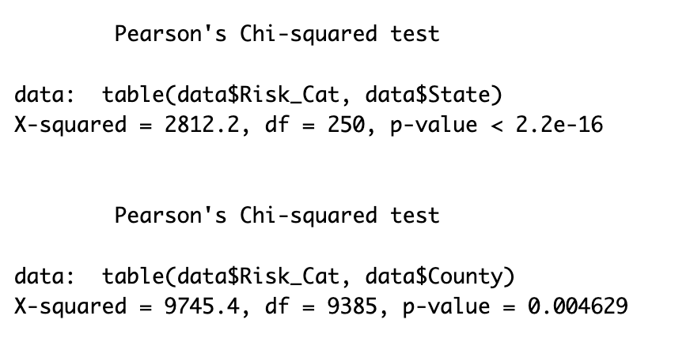
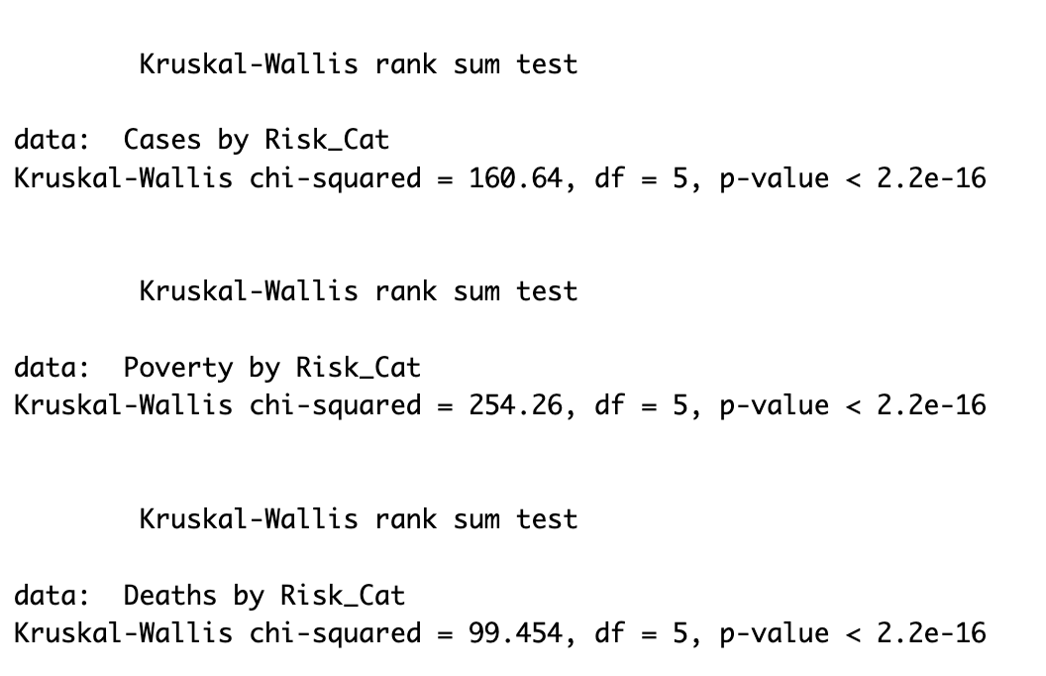
STATISTICAL ANALYSIS
As the p-value is less than 0.05, we reject the null hypothesis. Thereby, there is a significant association between the Risk category and Cases, ​Risk category and Deaths, Risk category and Poverty, Risk category and County, and Risk category and states.

Slide 27
STATISTICAL ANALYSIS
Kruskal-Wallis Tests
To understand the distribution of Cases, Poverty, and Deaths across different risk categories, we performed Kruskal-Wallis tests:
Cases by Risk Category: The result was highly significant (p-value < 2.2e-16).
Poverty by Risk Category: Again, the p-value was less than 2.2e-16, indicating strong differences.
Deaths by Risk Category: Similarly, the p-value was less than 2.2e-16, showing significant variations.

Slide 28
STATISTICAL ANALYSIS
In this analysis, we performed several statistical tests to examine the relationship between key variables such as risk categories, cases, deaths, and poverty. Here's what we found:
Chi-Square Test
We examined the relationship between risk categories and geographical factors like State and County.
Risk Category vs. State: The p-value was less than 2.2e-16, indicating a strong association.
Risk Category vs. County: The p-value was 0.0046, confirming a significant relationship between risk categories and counties

Slide 29
STATISTICAL ANALYSIS
Spearman’s Rank Correlation: Evaluated correlations between various demographic (population) and socioeconomic factors (poverty rate) and health outcomes (cases, deaths).
Key Findings:
As the p-value is less than 0.05, there is a strong correlation between the variables
Positive correlation between poverty and COVID-19 cases, showing socioeconomic factors' impact on the spread of the virus (slide 15).
Significant correlation between population size and the number of COVID-19 deaths and cases.
Significant correlation between poverty and the number of COVID-19 deaths and cases.

Slide 30
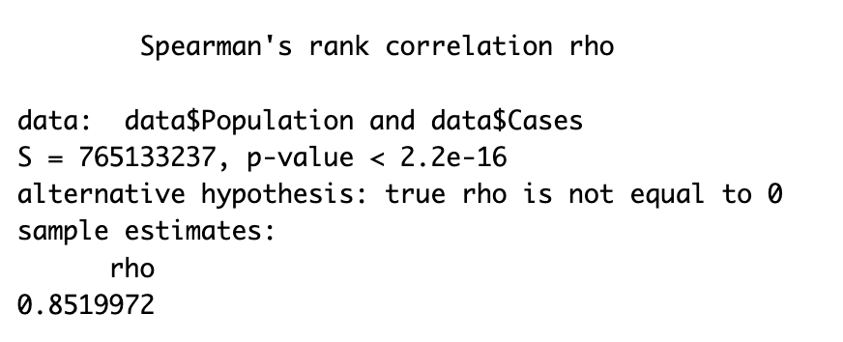
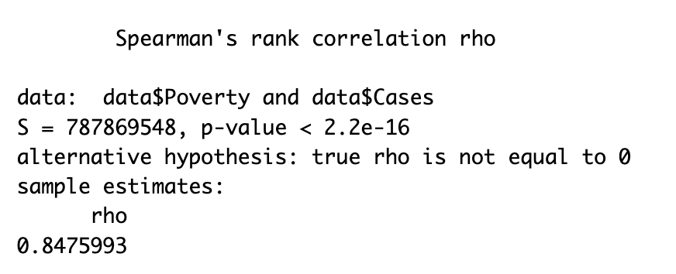
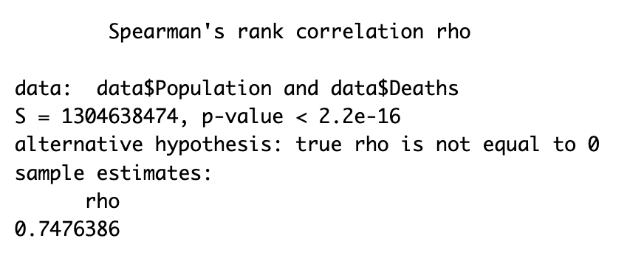
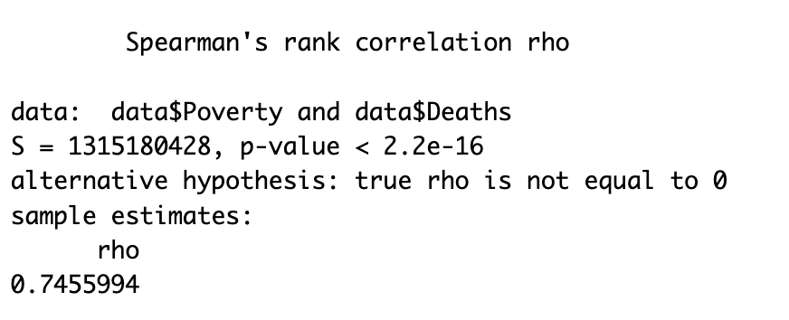

Slide 31
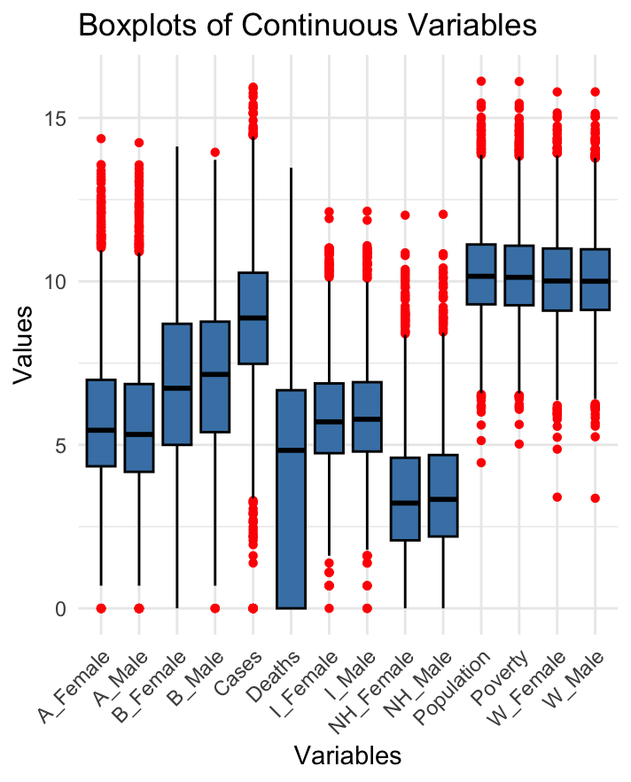
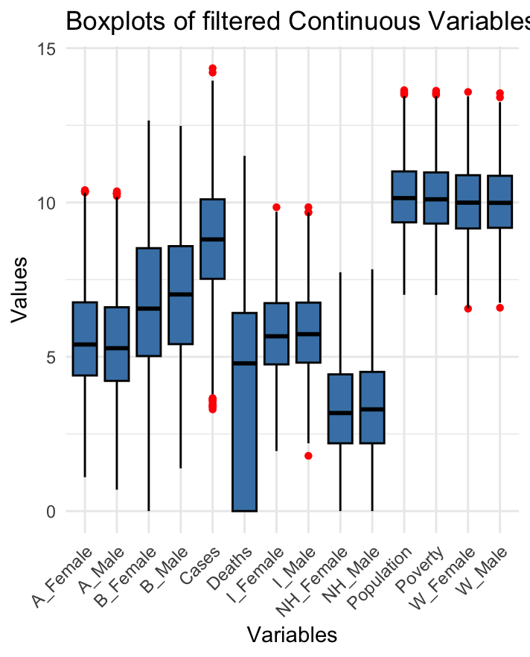
BEFORE AND AFTER REMOVING OUTLIERS USING THE IQR METHOD

Slide 32
LINEAR REGRESSION
Predicting Covid 19 Deaths using socio-economic and Racial Predictors

Slide 33
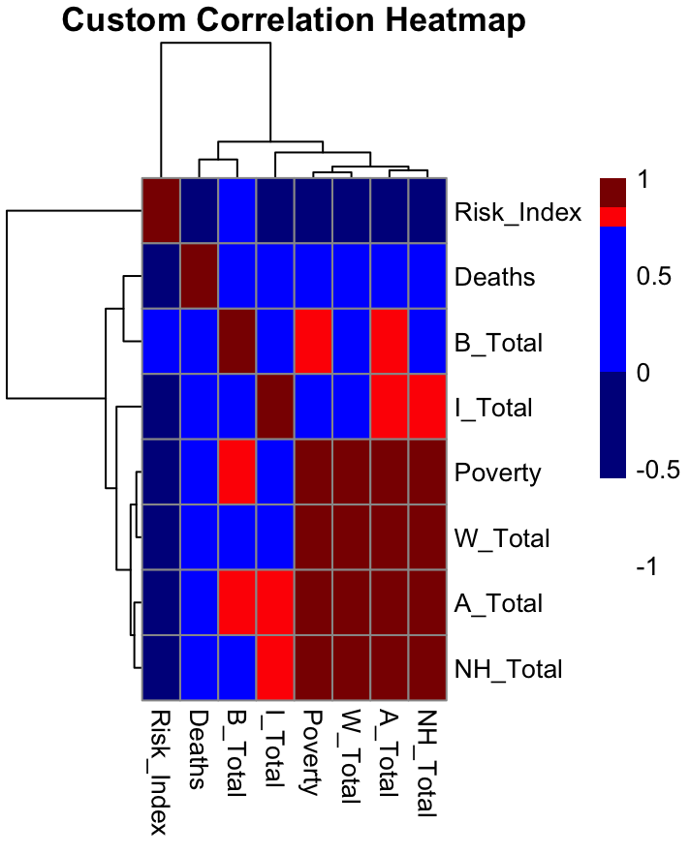
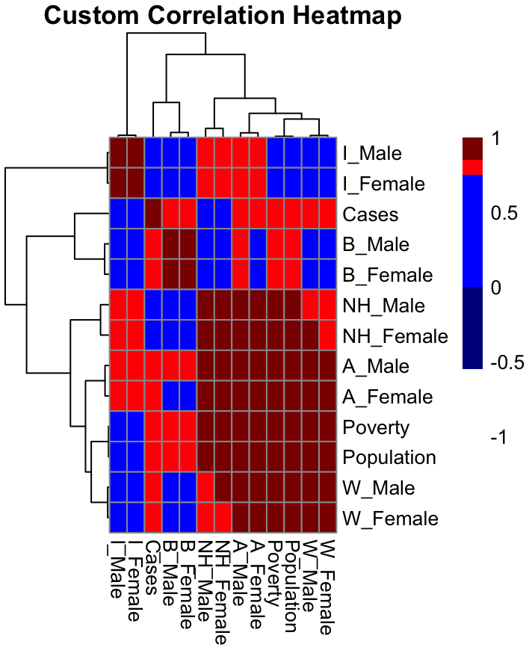
ADDRESSING MULTICOLLINEARITY
Male and Female populations are highly correlated among corresponding Racial populations
Poverty and Population are highly correlated (0.999)
Male and female populations are aggravated together to reduce collinearity.
Since populations are already accounted through racial populations, we have removed population and kept poverty in the model.

Slide 34
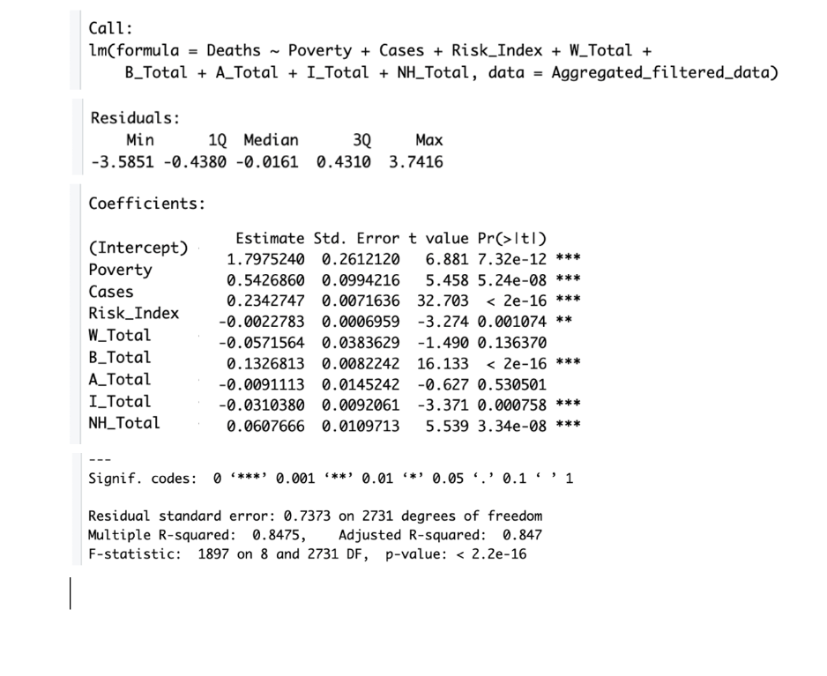
RESULTS AND DIAGNOSTIC PLOSTS
Dependent Variable: Deaths
Independent Variables: Poverty, Cases, Risk_Index, B_Total, A_Total, NL_Total.
Poverty: Positive and significant (p < 0.001). Higher poverty rates are associated with more deaths.
Cases: Positive and significant (p < 0.001). More cases contribute to increased deaths.
Adjusted R² = 0.8475: The model explains 84.75% of the variability in Deaths.

Slide 35
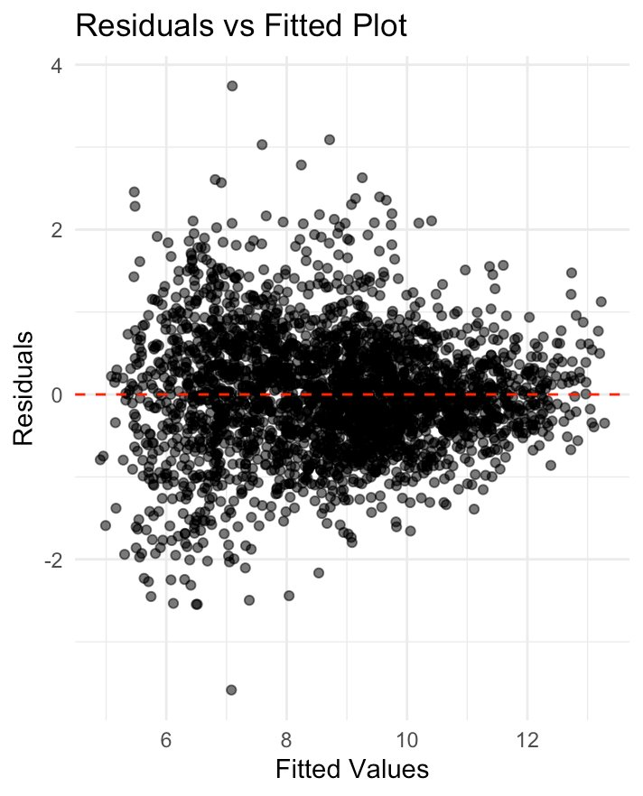
RESIDUAL VS FITTED PLOT
This Residuals vs Fitted plot helps assess the linearity and homoscedasticity in the regression model.
The majority of points are randomly scattered around the zero residual line, suggesting a decent fit.
However very slight funnel shape might indicate potential heteroscedasticity, where variance increases with fitted values.

Slide 36
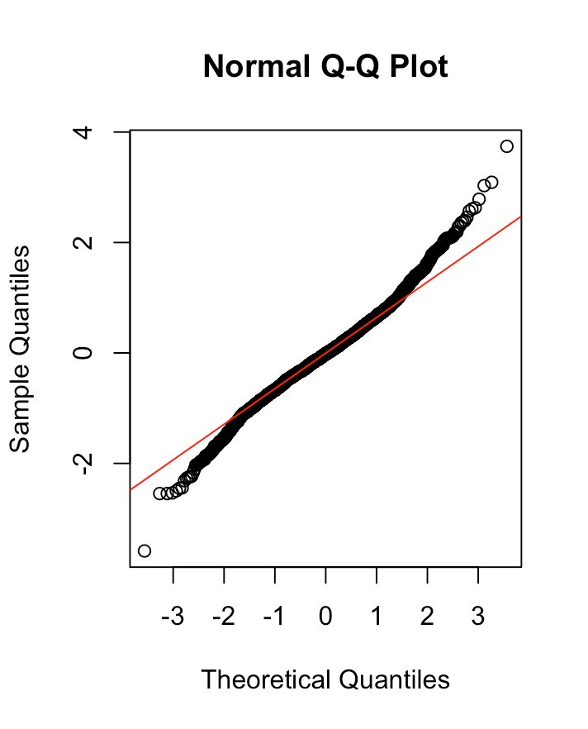
Normal Q-Q Plot
Points mostly align with the red diagonal line.
Deviations at the tails might indicate potential outliers or slight non-normality.
Residuals are reasonably normal but may need adjustments for extreme observations.

Slide 37
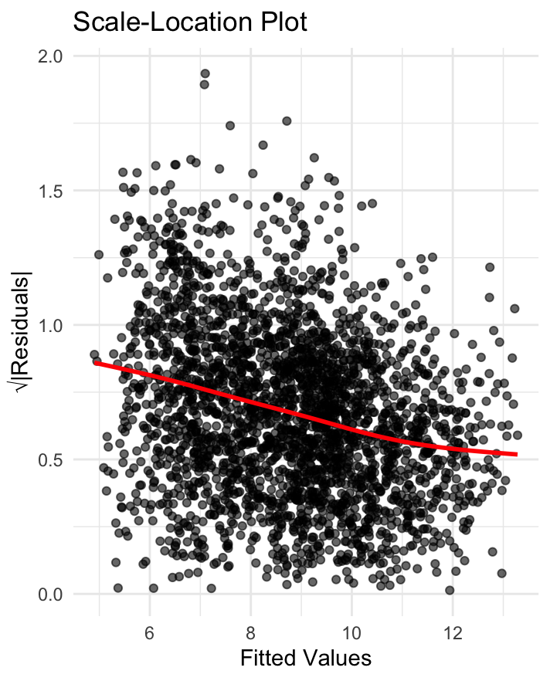
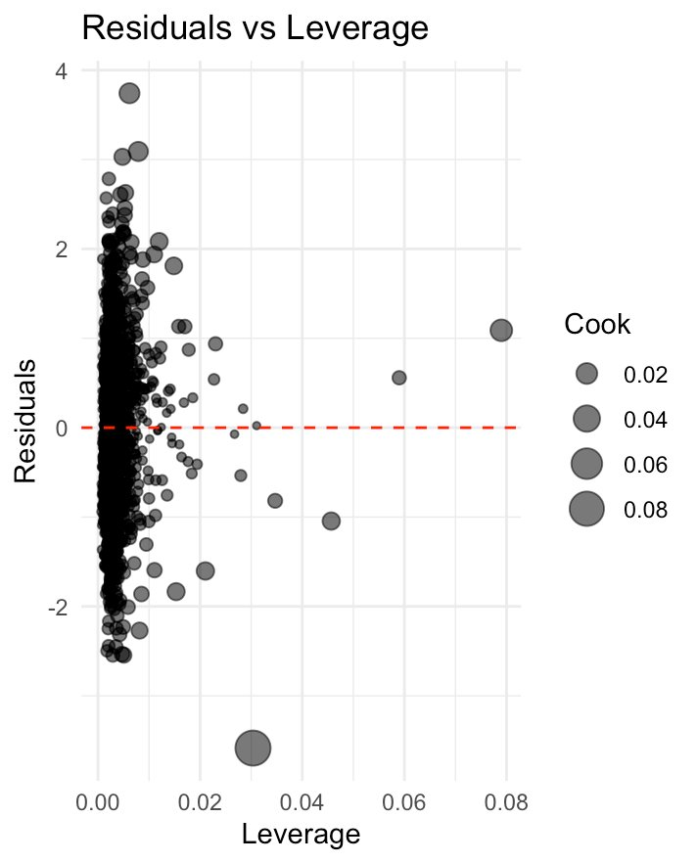
The Scale-Location Plot (also called the "Spread-Location Plot") helps verify the assumption of homoscedasticity, which means that the residual variance should remain constant across fitted values.
The downward slope of the red line indicates that the residual variance decreases as the fitted values increase. This suggests heteroscedasticity,
This plot helps identify influential points that can disproportionately affect the regression model.
Bubble size represents Cook’s Distance, a metric combining leverage and residual size to assess influence.

Slide 38
LOGISTIC REGRESSION
Predicting Covid 19 Risk category (multinomial classification) using socio-economic and Racial Predictors

Slide 39
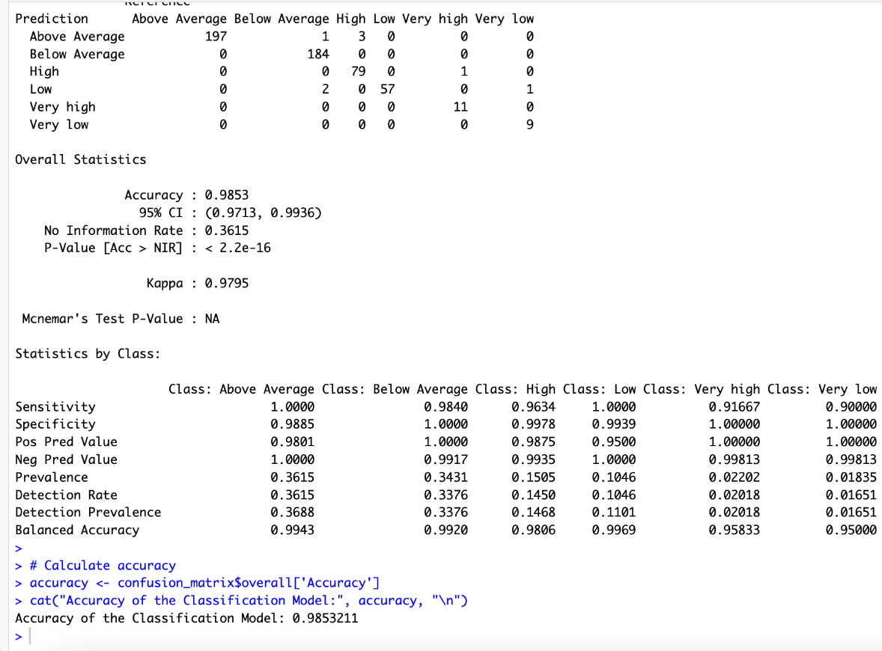
RESULTS AND DISCUSSION
Dependent Variable (Risk_Cat): A categorical variable (e.g., Above Average, Below Average, etc.)
Independent Variables: Predictors such as Poverty, Cases, and totals for various groups (W_Total, B_Total, NH_total etc).
This confusion matrix compares the predicted and actual class values for the dependent variable: Diagonal Values: These represent correct classifications. High diagonal counts indicate good model performance. Off-Diagonal Values: These represent misclassifications.
Accuracy is 98.53% of predictions were correct. The true accuracy is likely within this range of Confidence Interval (CI) (0.9713,0.9936)
Sensitivity (Recall): Measures the proportion of true positives identified for each class.
Specificity: Measures the proportion of true negatives for each class.
Precision (Positive Predictive Value): Measures the accuracy of positive predictions
Balanced Accuracy: An average of sensitivity and specificity for each class, useful for imbalanced datasets

Slide 40
Relevance to Research Questions:
EDA Techniques: Provided insights into variable distributions, relationships, and the impact of independent and dependent variables that are demographic, socioeconomic factors and COVID-19 outcomes.
Alignment with the Research Question: The selected statistical methods directly address the research questions by identifying patterns and relationships between independent variables (socioeconomic, demographic, and racial factors) and dependent variables (COVID-19 deaths, and risk categories). For example, the Kruskal-Wallis test highlighted significant variations in COVID-19 outcomes across risk categories, while the Chi-Square test demonstrated geographic disparities in risk.
Evaluation of Complex Relationships: The combination of these methods allowed for a multifaceted analysis, considering both continuous and categorical data, and helped uncover the influence of different factors on COVID-19 outcomes.
Limitations of the Methods:
Outlier Removal: Eliminating outliers might reduce variability and overlook extreme cases.
Correlation, Not Causation: The study identifies significant associations but does not establish causality. For example, while poverty is correlated with higher COVID-19 cases and deaths, this does not imply a direct cause-and-effect relationship without additional analysis of underlying mechanisms.
Data Distribution Assumptions: While non-parametric tests are robust for non-normal data, they are less sensitive than parametric tests, potentially limiting the detection of small but meaningful differences.

Slide 41
Conclusion
Key Findings:
The analysis reveals notable demographic disparities in COVID-19 cases, with racial diversity and socioeconomic factors such as poverty significantly influencing the distribution and severity of cases across U.S. counties.
Spearman's rank correlation analysis shows a strong positive relationship between poverty rates and the number of COVID-19 cases, highlighting the critical role of economic factors in the pandemic's impact.
The linear regression model with an R² = 0.8475 explain 84% of the variability in deaths and shows a significant relationship between deaths and poverty, cases, and risk index.
The logistic regression model with an accuracy of 98.53% shows a significant relationship between risk category and racial, demographic, and socio-economic factors
Implications for Public Health: These findings underscore the importance of addressing both social determinants of health (e.g., poverty) and demographic factors in public health interventions. Targeted health policies are essential to reduce health disparities and ensure equitable access to healthcare, particularly in high-risk communities.

